Slide 1
Netflix stock prediction minor project
Group members-Shubham Chakraborty ,Satish Mourya and Manav Gupta

Slide 2
conclusion
In the realm of financial analysis, the exploration of Netflix's stock prices through a comprehensive time series analysis has unveiled a trove of valuable insights and revelations. Our journey commenced with a meticulous introduction to the dataset, providing a holistic view of its contents, source, and the analytical approach adopted. Through the lens of Exploratory Data Analysis (EDA), we embarked on a quest to unravel the mysteries encoded within the temporal fluctuations of Netflix's stock performance.
The data overview offered a panoramic snapshot of Netflix's stock prices, spanning from 2023 to 2024. We navigated through the seas of data cleaning, ensuring the integrity and reliability of our dataset for further analysis. Armed with a refined dataset, our voyage delved into the depths of time series analysis, where we charted the course of Netflix's stock prices over time.
Time series visualization served as our compass, guiding us through the turbulent waves of market dynamics. We marveled at the intricate patterns, trends, and seasonalities woven into the fabric of Netflix's stock prices. Descriptive statistics provided a compass rose, offering a compass rose, offering insights into the central tendencies and variability of the data.
In conclusion, our expedition into the seas of Netflix's stock prices has been a voyage of discovery, enlightenment, and empowerment. Armed with the insights gleaned from our analysis, stakeholders are equipped to navigate the ever-changing currents of the financial market with confidence and clarity.

Slide 3
Introduction:
In this analytical report, we delve into the intricate landscape of Netflix's stock prices, utilizing a comprehensive dataset spanning from 2023 to 2024. This introductory section provides a brief overview of the dataset, its source, contents, and outlines the analytical approach employed for the exploratory data analysis (EDA).

Slide 4
Contents of Data
Encompassing various facets of Netflix's stock market journey, the dataset comprises essential columns elucidating crucial aspects of stock pricing. These include: Date: Recording the trading days over the specified time frame. Open: Signifying the opening price of Netflix stock on each trading day. High: Reflecting the highest price at which Netflix stock traded during the day. Low: Denoting the lowest price at which Netflix stock traded during the day. Close: Indicating the closing price of Netflix stock on each trading day. Adjustment Close: Presenting the adjusted closing price, accounting for events such as dividends and stock splits. Volume: Representing the total number of shares traded on each trading day.

Slide 5
Overview of The Data
I'll kick off our data exploration journey by summoning the mighty Pandas Library, a powerful ally renowned for its prowess in wielding datasets. Together, we'll embark on a quest to uncover the secrets hidden within our data, shedding light on its enigmatic depths and revealing the stories it yearns to tell.

Slide 6
DATA CLEANING
Now that we've unveiled the initial layers of our dataset, it's time to polish our treasure trove and ensure its integrity for further exploration. In this phase of our adventure, we'll embark on the noble quest of data cleaning, where we'll sift through the sands of our dataset, vanquishing inconsistencies, taming outliers, and smoothing rough edges. Our goal? To sculpt our data into a pristine masterpiece, ready to yield its hidden gems at our command.

Slide 7
Time Series Analysis
Time series analysis is a powerful statistical technique used to analyze and interpret data points collected at successive intervals of time. Unlike traditional cross-sectional data analysis, which focuses on observations at a single point in time, time series analysis delves into the temporal patterns, trends, and dependencies present in the data. It finds applications across various domains, including finance, economics, meteorology, and engineering, where understanding the behavior of a phenomenon over time is crucial for decision-making and prediction. Time series data often exhibits unique characteristics such as trend, seasonality, autocorrelation, and volatility, which necessitate specialized analytical techniques for exploration and forecasting. Through time series analysis, practitioners can uncover valuable insights, detect anomalies, model relationships, and make informed predictions about future outcomes, thereby enabling proactive decision-making and strategic planning. This introductory paragraph sets the stage for a deeper dive into the methods and tools used in time series analysis, empowering analysts to extract meaningful insights and derive actionable conclusions from temporal data.

Slide 8
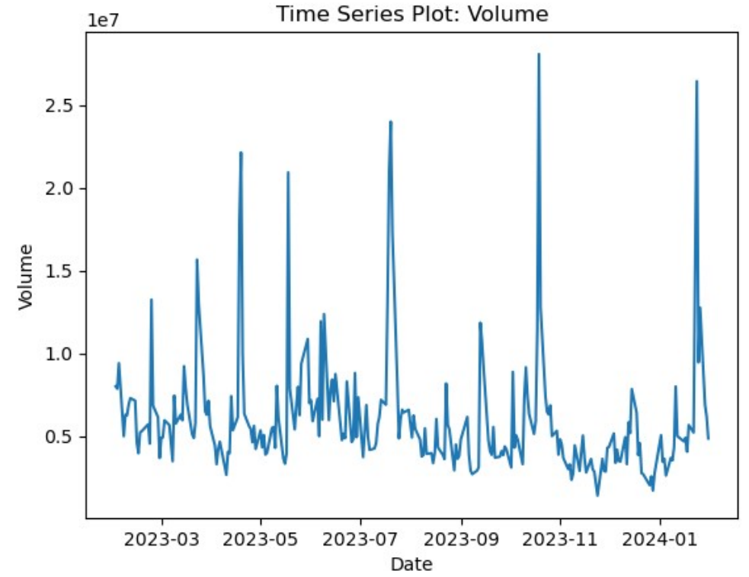
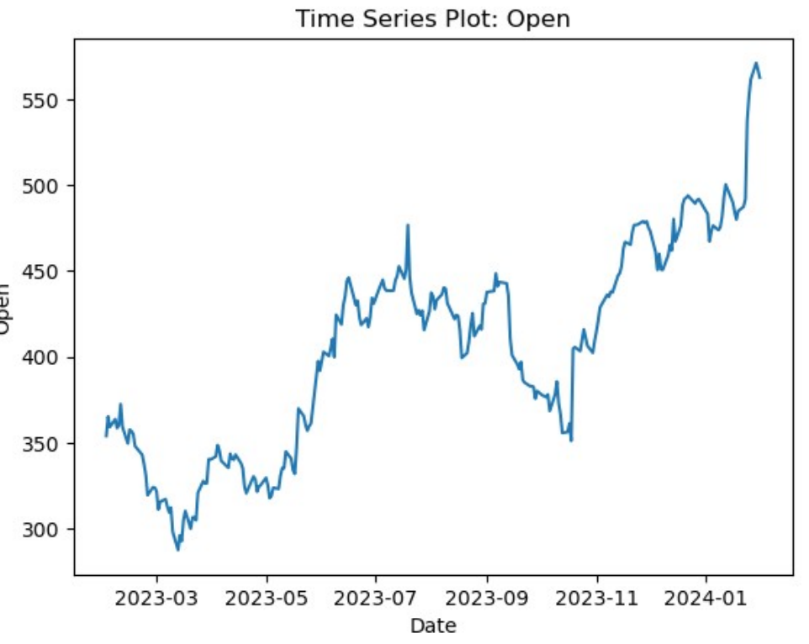
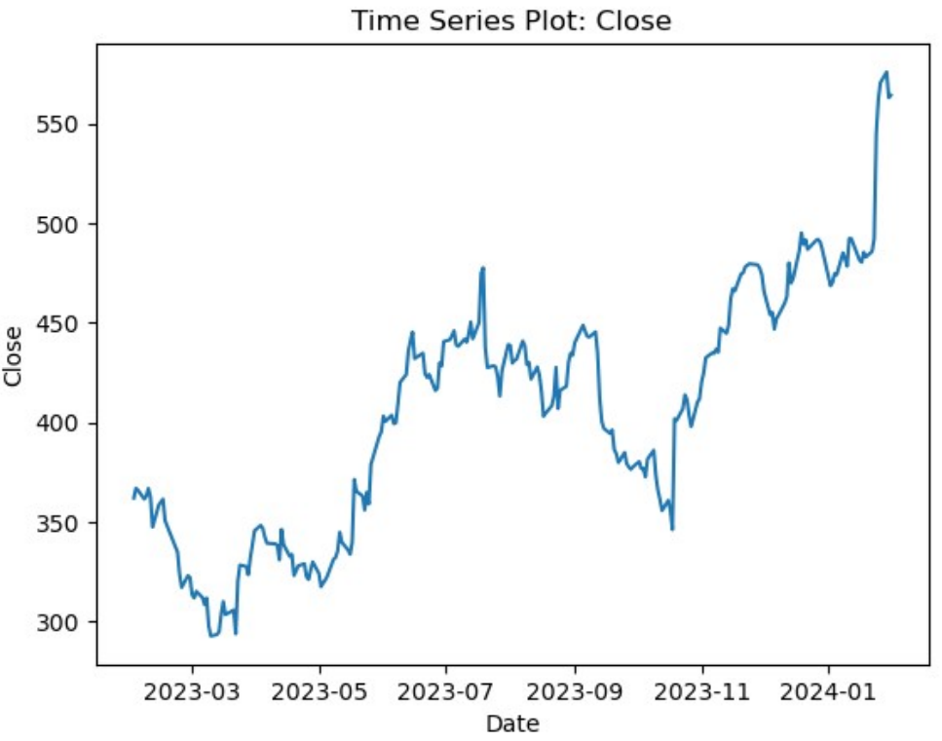

Slide 9
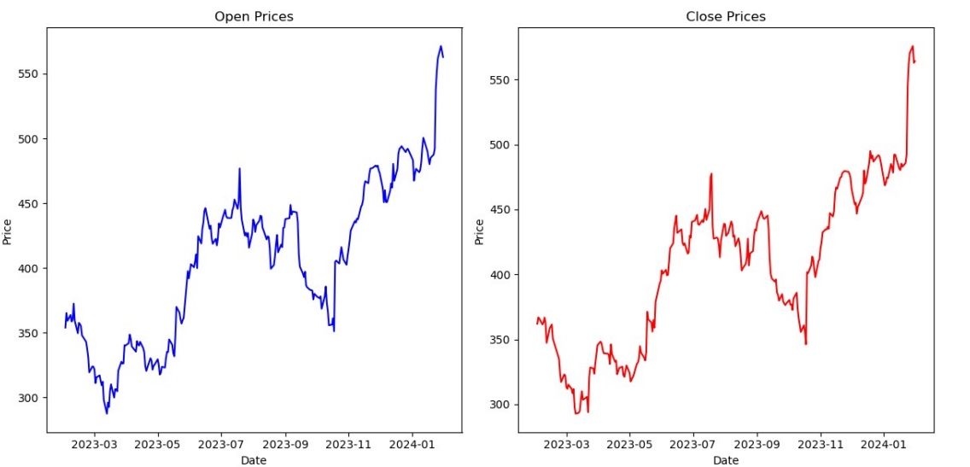
Comparison between open and close price graph

Slide 10
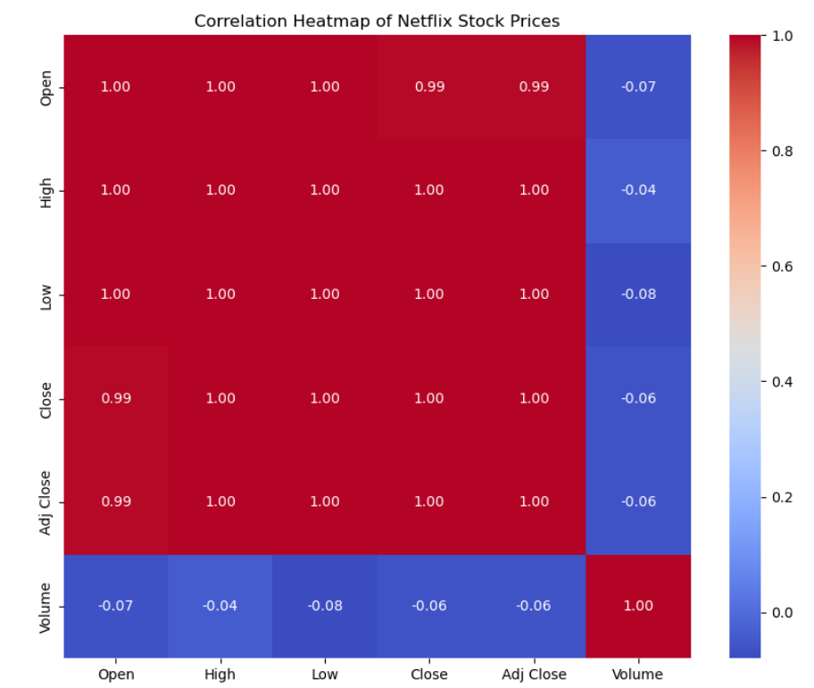
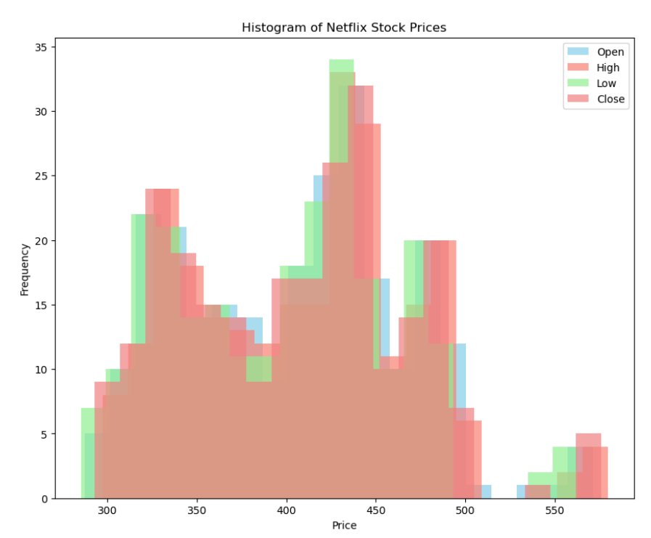
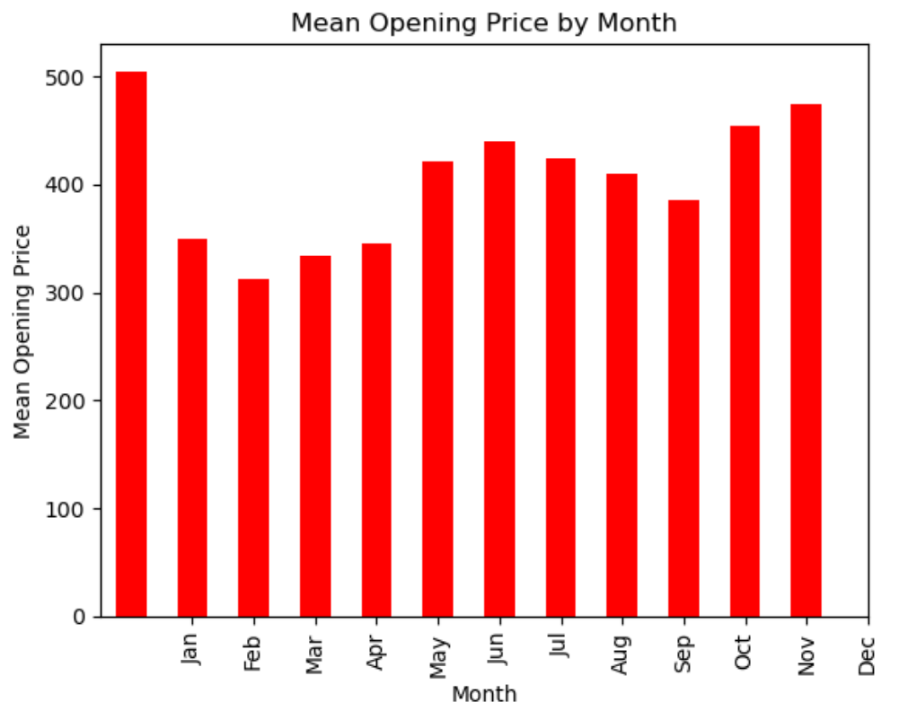
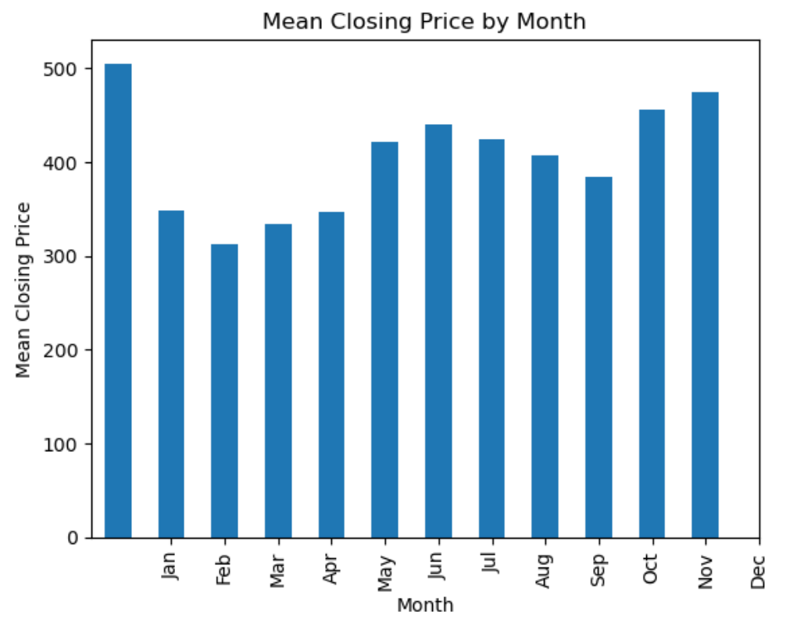
Seasonality in Stock Prices

Slide 11
Predictive Analysis
Model Prediction: In the realm of financial analysis, model prediction plays a pivotal role in forecasting the future trajectory of stock prices. Leveraging advanced statistical techniques, analysts can develop models that harness historical data to make informed predictions about future price movements. These predictions serve as valuable insights for investors, guiding their decisionmaking processes and informing strategic investment choices.
Potential Outcome of Predictions: The outcomes of prediction hold significant implications for investors and stakeholders in the financial market. Accurate predictions enable investors to anticipate market trends, identify profitable investment opportunities, and mitigate risks associated with market volatility. Conversely, inaccurate predictions can lead to suboptimal investment decisions, resulting in financial losses and missed opportunities. Therefore, the reliability and precision of prediction models are paramount for enhancing investment performance and maximizing returns.
Approaches: Linear Regression: In the realm of stock price prediction, two commonly employed approaches are Linear Regression and Polynomial Regression. These regression techniques aim to establish a mathematical relationship between input variables, such as historical stock prices and trading volume, and the target variable, which is typically the future stock price. By fitting a regression model to historical data, analysts can extrapolate this relationship to predict future price movements. I will be using Linear Regression on this analysis.
Target Variable and Inout Features: In the context of stock price prediction, the target variable is typically the future stock price that analysts seek to predict. This could be the closing price of the stock on a future trading day. The input variables, also known as features, are historical data points that serve as predictors for the target variable. These can include past stock prices (e.g., open, high, low), trading volume, and any other relevant financial indicators that may influence the future price movements of the stock. By analyzing the historical relationship between these input variables and the target variable, analysts can develop predictive models to forecast future stock prices

Slide 12
Linear Regression
So, I will be using Linear Regression and since we have multiple input featurs the formula will be:
f (w , b) ( x)=w⋅ x+b=w1 x1+w2 x2+…+wn xn+b
Here: f (w, b) = Representation of prediction made by Linear Regression
w = weights assigned to each coefficient
b = Bias Term/Intercept term x = input features where x1 , x2 , . .. , xn denotes individual features w1 , 22 ,. . .,wn = weights assigned to each feature

Slide 13
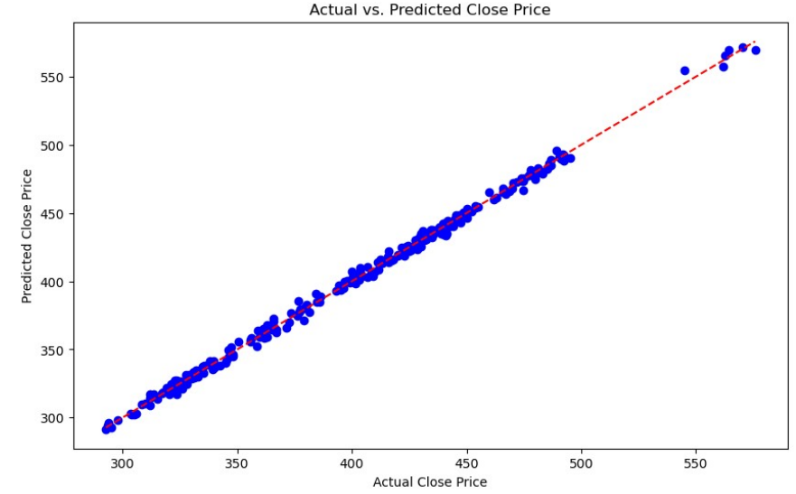
Actual vs predicted close price

Slide 14
conclusion
In the realm of financial analysis, the exploration of Netflix's stock prices through a comprehensive time series analysis has unveiled a trove of valuable insights and revelations. Our journey commenced with a meticulous introduction to the dataset, providing a holistic view of its contents, source, and the analytical approach adopted. Through the lens of Exploratory Data Analysis (EDA), we embarked on a quest to unravel the mysteries encoded within the temporal fluctuations of Netflix's stock performance.
The data overview offered a panoramic snapshot of Netflix's stock prices, spanning from 2023 to 2024. We navigated through the seas of data cleaning, ensuring the integrity and reliability of our dataset for further analysis. Armed with a refined dataset, our voyage delved into the depths of time series analysis, where we charted the course of Netflix's stock prices over time.
Time series visualization served as our compass, guiding us through the turbulent waves of market dynamics. We marveled at the intricate patterns, trends, and seasonalities woven into the fabric of Netflix's stock prices. Descriptive statistics provided a compass rose, offering a compass rose, offering insights into the central tendencies and variability of the data

